Slide 1






Generalization of CNNs on Relational Reasoning with Bar Charts
Zhenxing Cui*, Lu Chen*, Yunhai Wang, Daniel Haehn, Yong Wang, Hanspeter Pfister

Slide 2
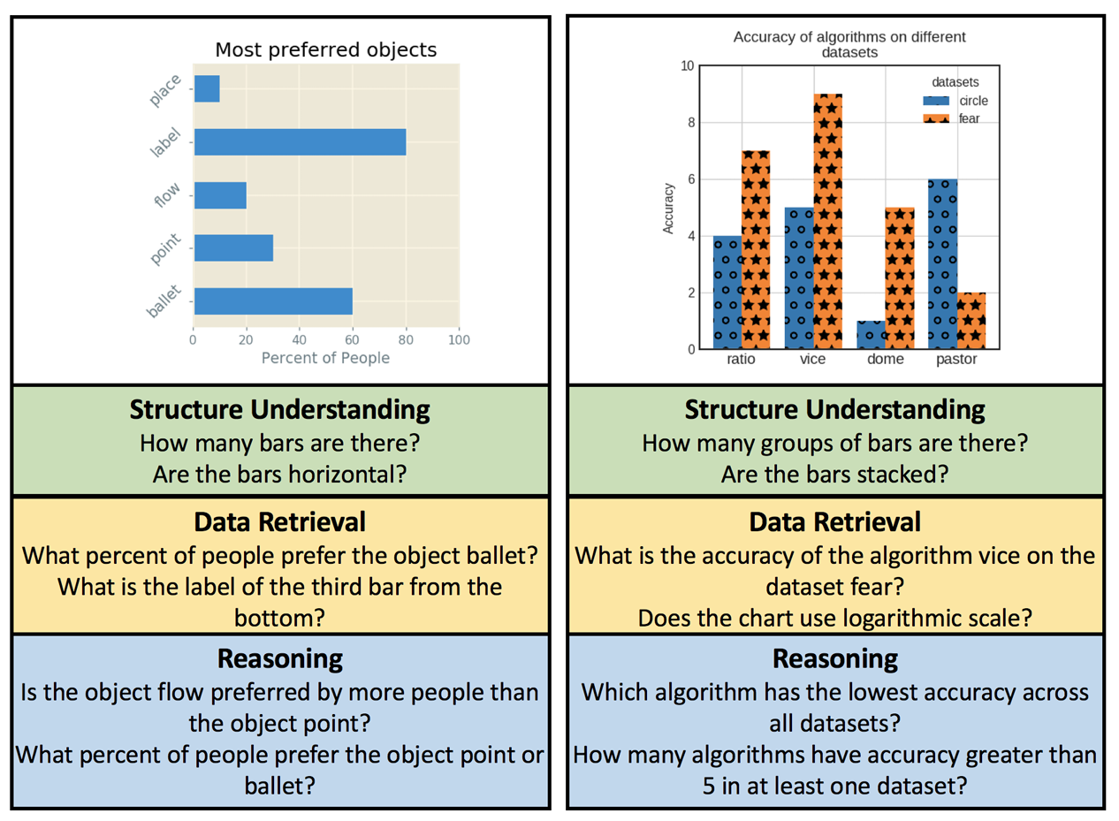
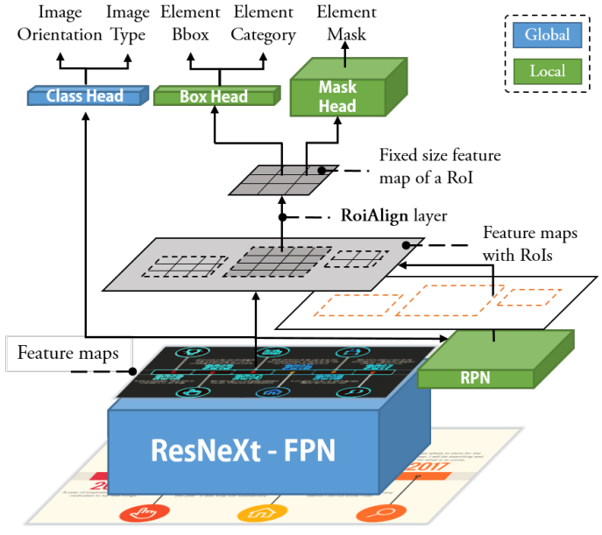
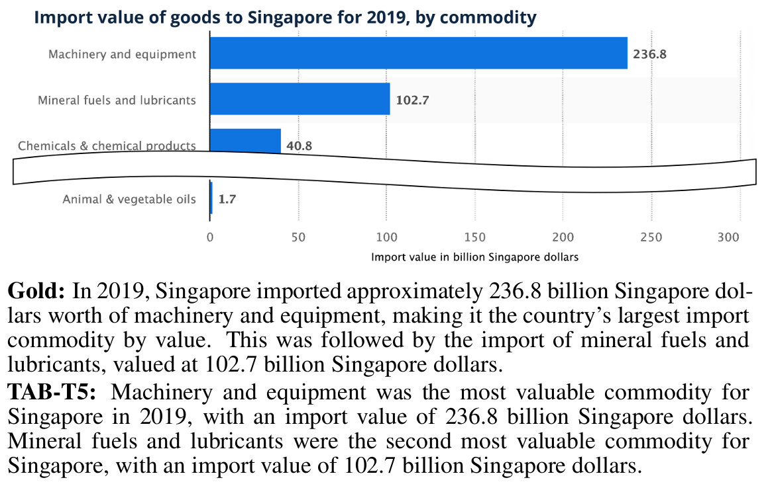
Background
Convolutional Neural Networks (CNNs) are widely used for many visualization tasks
But it remains underexplored how CNNs’ graphical perception performance generalizes across visualization design variations
Chart Question Answering
Automated Chart Design
Chart Captioning
Notes:
As for the background, CNN has been widely used for many visualziation tasks, such as ...
All these tasks depend on an accurate and systematic understanding of CNNs’ graphical perception performance, which unfortunately are still underexplored, especially across different visualization design variations.

Slide 3
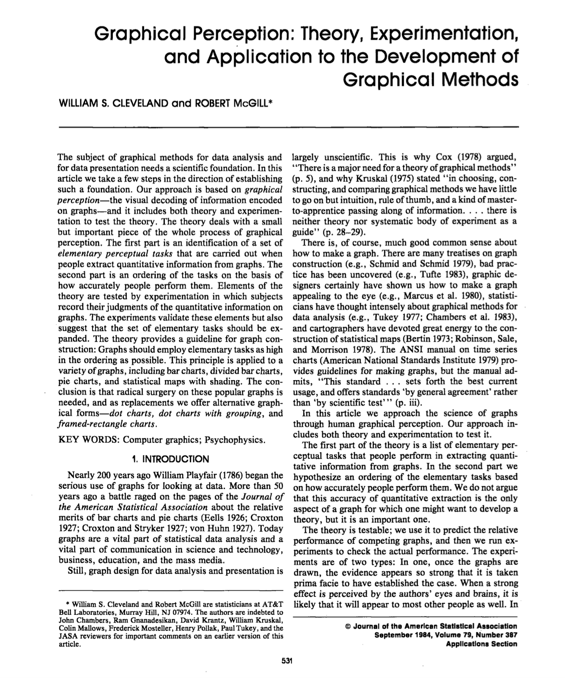
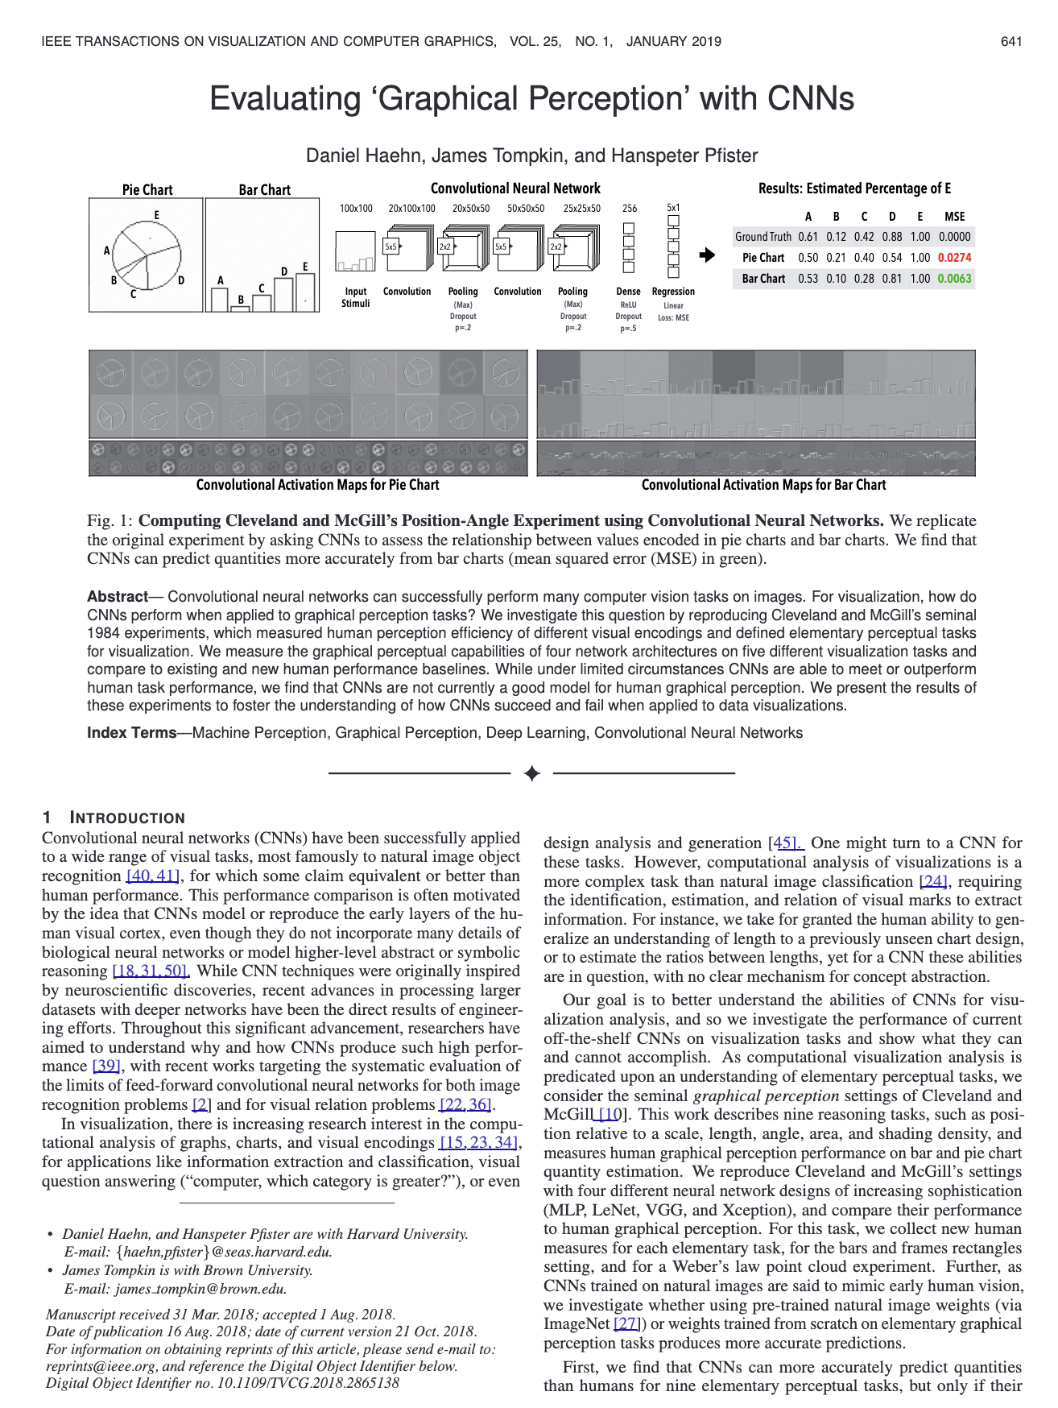
Background
Graphical Perception: the ability to decode visually encoded quantities in visualizations
Cleveland & McGill, 1984
Haehn et al., 2019
Notes:
Our work is inspired by prior research on graphical perception, especially the Seminal work by cleveland and mcgil and Daniel's early work on CNN's graphical perception.

Slide 4
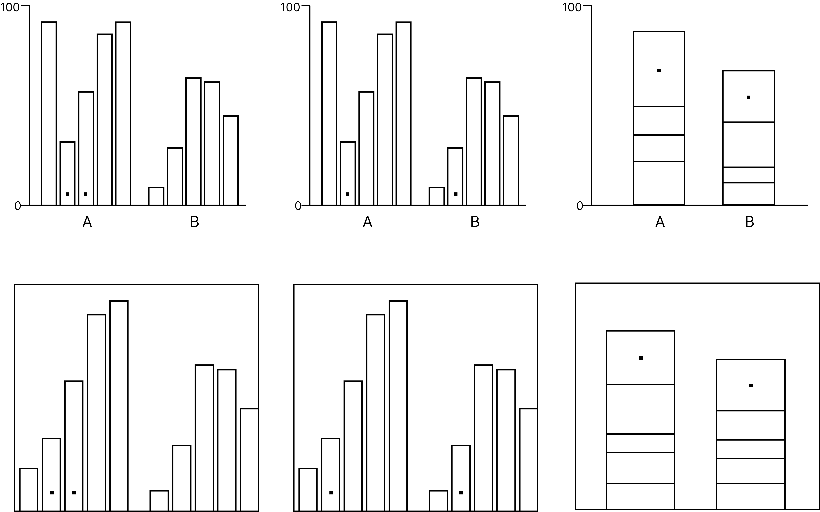
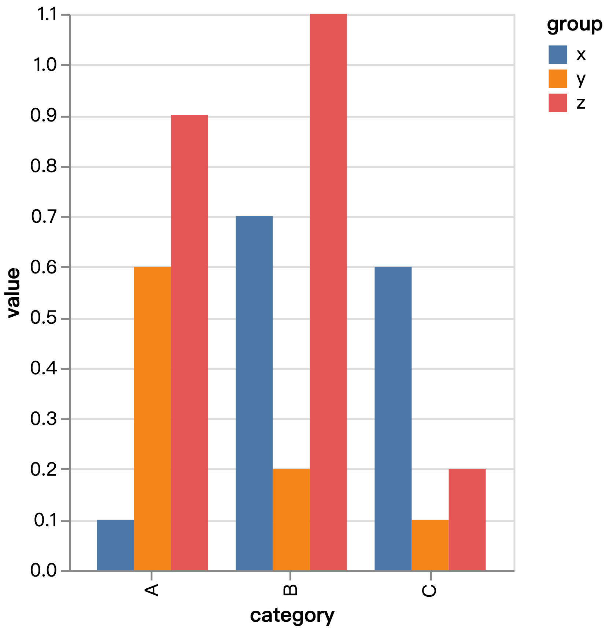
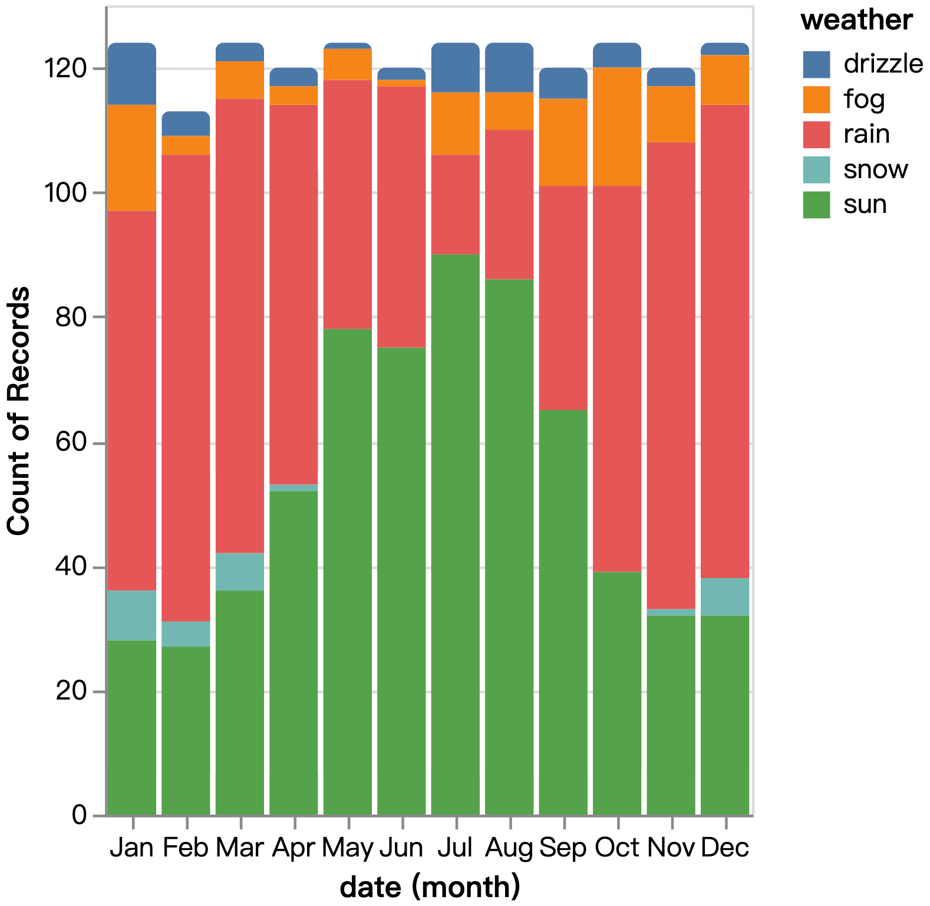
Background
Graphical Perception: the ability to decode visually encoded quantities in visualizations
Oversimplified Charts
Standard Visualizations
Notes:
However, there are two major issues in these priror studies.
- Oversimplified charts, not standard visualizations as what we will see in real-world applications. For example, there will be titles, colors, legends, etc. It makes the conclusions from prior studies really questionable or at least not comprehensive.
- It remains unclear regarding the performance of CNNs across different model architectures and visual encoding perturbations.

Slide 5
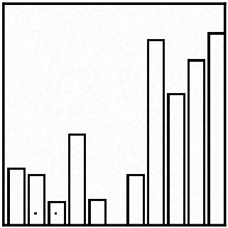
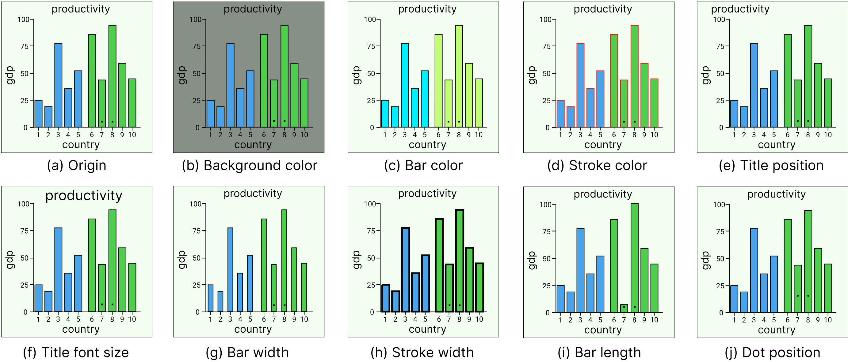
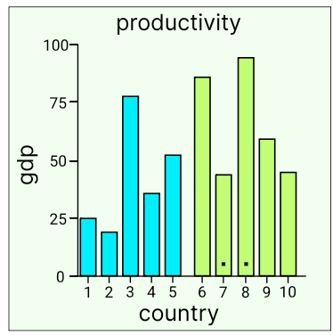
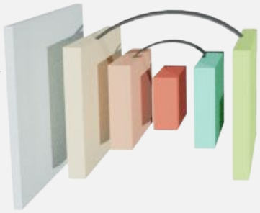
Research Questions
How well do CNNs perform on standard visualizations with full design elements?
How robust are CNNs to design perturbations such as color jitter?
What are the differences between CNNs and humans in visual relational reasoning?
？
Perturb
Train
Test
？
Notes:
So in this paper, we try to answer three key research questions:

Slide 6
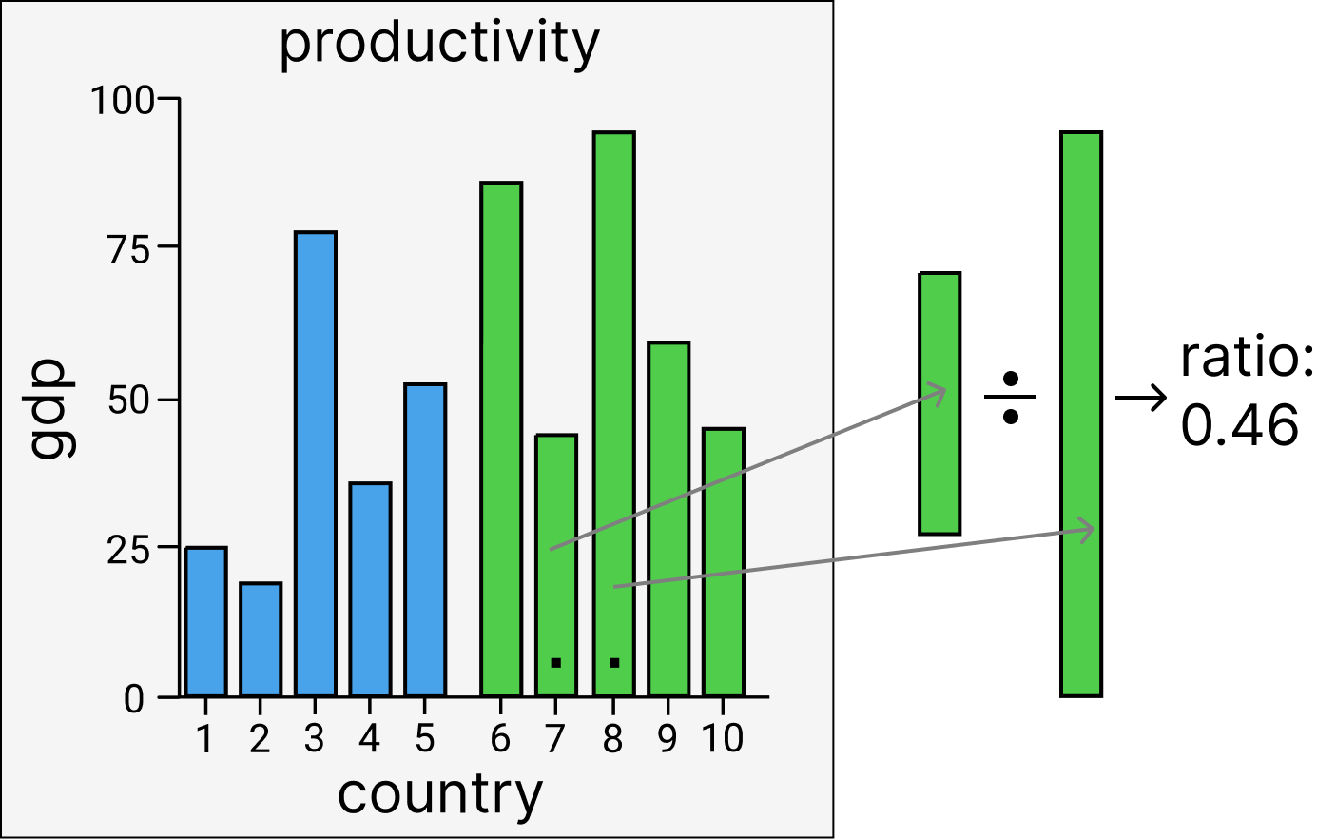
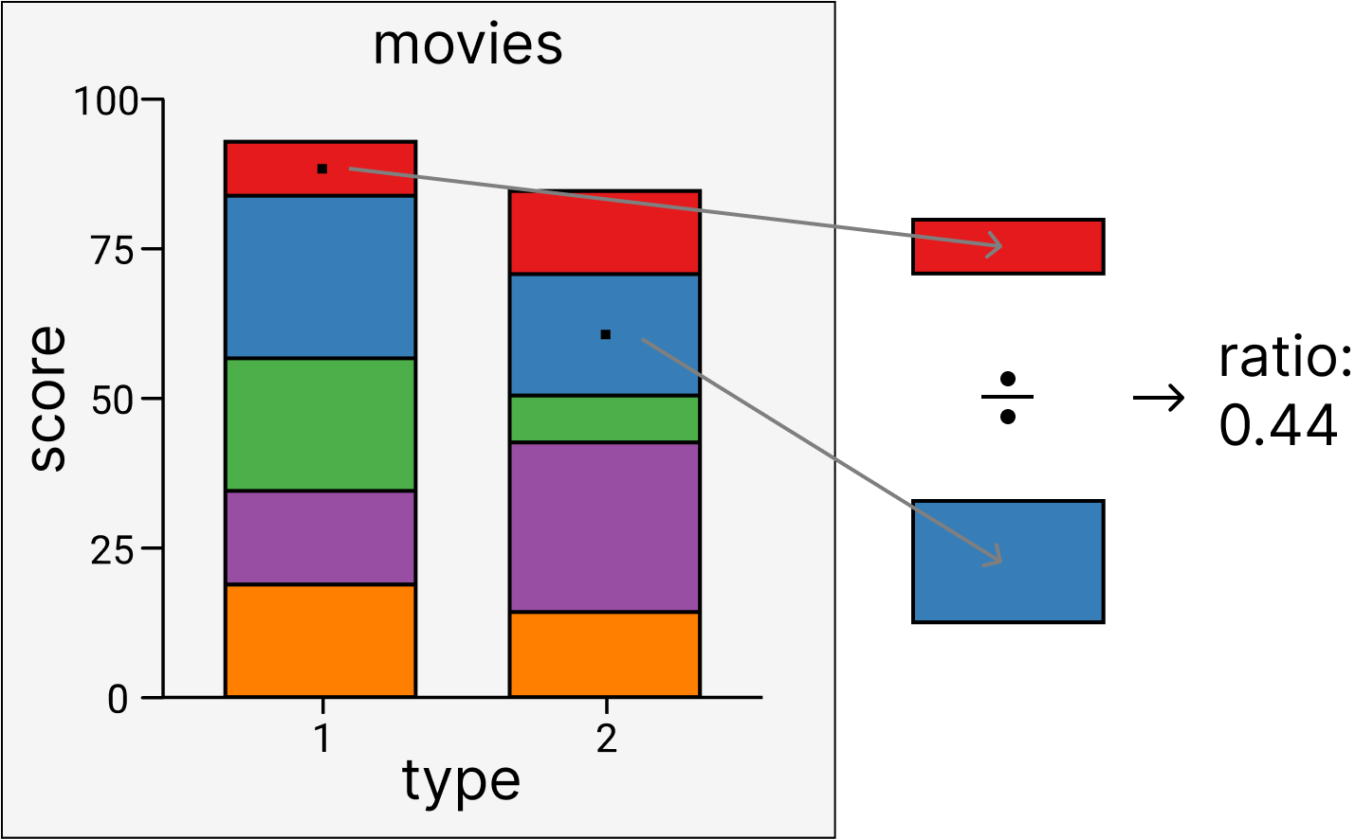
Relational Reasoning in Graphical Perception
Task: Estimate the ratio of lengths (i.e., heights) between two target bars (targets indicated by black dots)
Notes:
For the task of relational reasoning in graphical perception, we follow the setup of prior studies. Basically, we ask the CNN models to estimate the ratio of ...

Slide 7
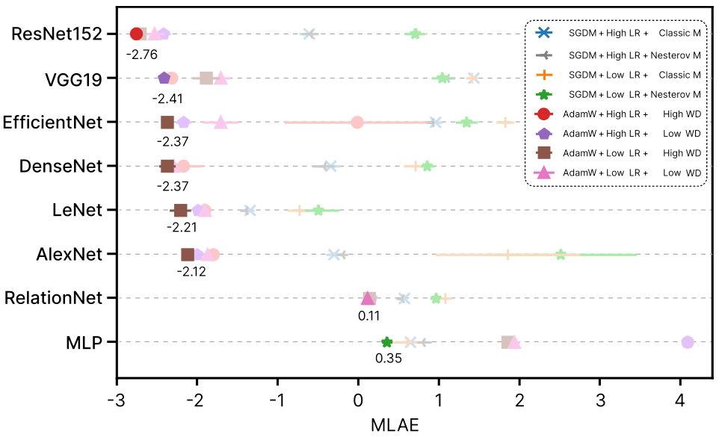
Benchmarking Representative CNNs
Replicate Haehn et al.’s experiments [1] with systematically-tuned CNNs
CNNs achieve very strong performance, better than previously-reported results
Architectures
Optimizers
MLP
AlexNet
LeNet
DenseNet
VGG19
ResNet152
Xception126
EfficientNet
AdamW
SGDM
Hyper-parameters
Learning rate
Momentum
Weight decay
[1] D. Haehn, J. Tompkin, and H. Pfister. Evaluating ‘graphical perception’ with CNNs. IEEE Transactions on Visualization and Computer Graphics, 25(1):641–650, 2019.
Notes:
To conduct such an evaluation, the first question we need to answer is: which CNN should be used here? CNNs are not only one model, it is actually a group of model architectures, combined with different training setup. So what we have done is that we tested different combinations of model architectures, optimizers, and hyperparameters.
Midmeans of log absolute errors (MLAE), the smaller the better.
ResNet 152 is used for the subsequent experiments.

Slide 8
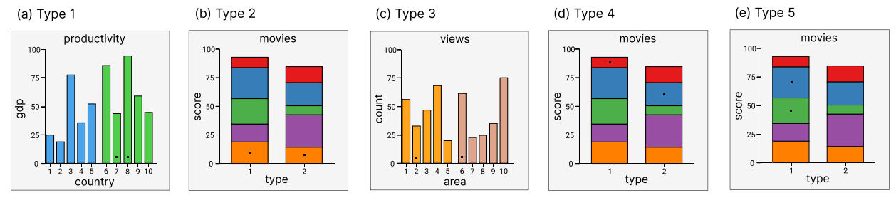
GRAPE: A GRAphical PErception Dataset
Five bar-chart types synthesized programmatically with Vega-Lite
766K (500K for training & 266K for testing) standard visualizations
Large and controllable dataset to manipulate design parameters
Notes:
The second question we need to answer is: what kind of labeled standard visualization datasets should be used here? Unfortunately, there are still no such datasets.

Slide 9
Perturbation Setup
9 visual parameters: title position, title size, background color, bar color, stroke color, bar width, stroke width, bar length, dot position
Independent and Identically Distributed (IID): test visualizations have similar encodings with the training samples
Out-of-distribution (OOD): test and training visualizations are different
Perturbation
Notes:
For the standard visualizations in our datasets, we impose perturbations on 9 visual parameters, such as title position, title size ….
In our final experiments, we consider two conditions: independent and identically distributed (IID) condition and out-of-distribution (OOD) conditions.

Slide 10
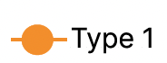
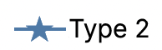
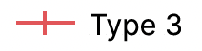
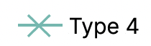
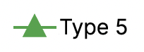
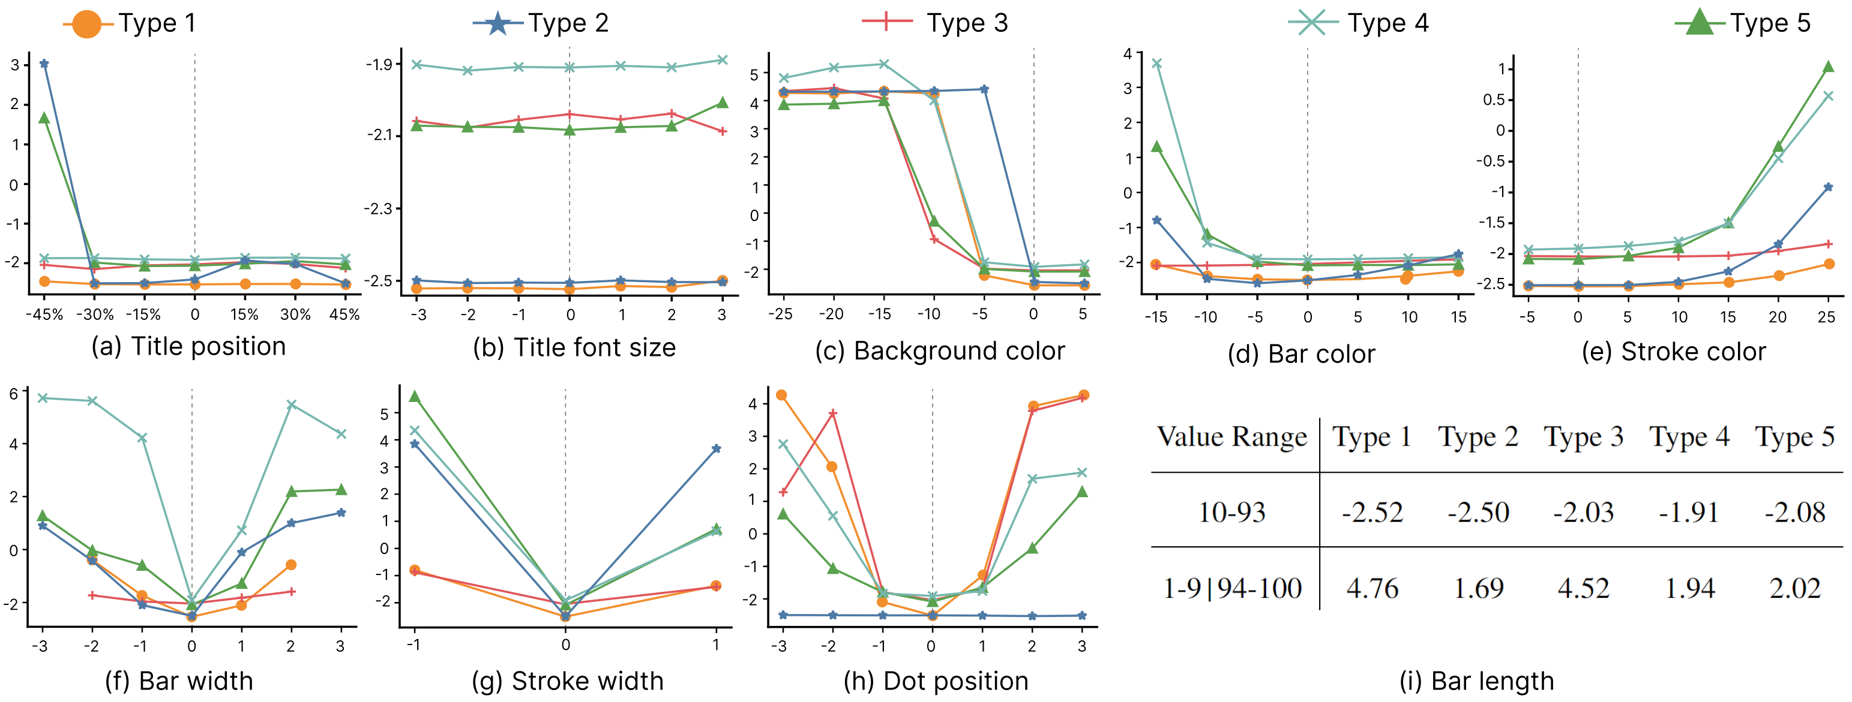
Results (IID): CNNs are Excellent
Notes:
CNNs are excellent in the IID conditions, as shown in the figures.
For each figure,
X-axis: perturbations of different visual parameters. Y-axis: Midmeans of log absolute errors (MLAE), the smaller the better.
Each curve shows how the MLAE values change by increasing or decreasing the corresponding visual parameter perturbation.
The IID condition corresponds to the cases where there is 0 perturbation of different visual parameters. Basically, CNNs show perfect graphical perception capabilities in the IID conditions.

Slide 11
Results (OOD): CNN Robustness Collapses on Visual Parameter Shifts
Notes:
However, CNN robustness collapse on visual parameter shifts, as shown in the figures.

Slide 12
Results (OOD): CNN Robustness Collapses on Visual Parameter Shifts
Small changes in bar width, stroke width, and dot position → Big errors
Notes:
More specifically, ….

Slide 13
Results (OOD): CNN Robustness Collapses on Visual Parameter Shifts
Even “irrelevant” parameters (e.g., title position) affect graphic perception performance
Background luminance drops sharply push up prediction error
CNNs are relatively robust to changes of title font size, bar and stroke colors
Notes:
Also, even …

Slide 14
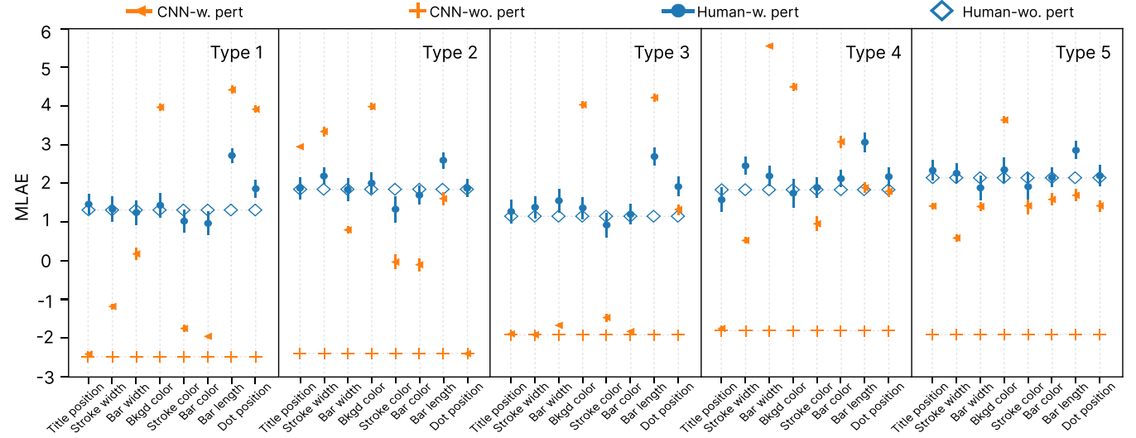
Humans vs CNNs
Humans are worse than CNNs in IID conditions but more robust under perturbations (OOD)
Interview feedback: participants focus on target bars; ignore nonessential styling
Notes:
====
Humans are mainly influenced by bar length range; CNNs by many parameters

Slide 15
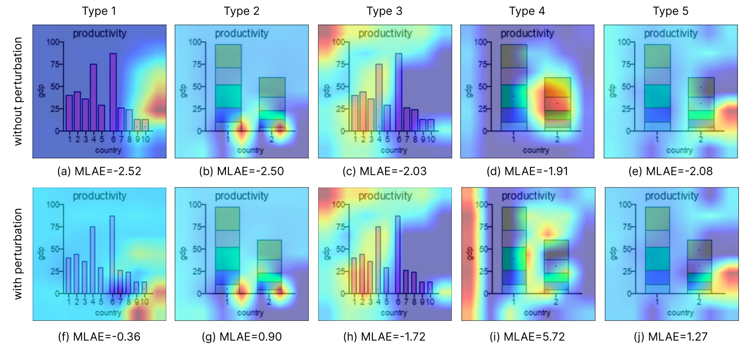
Why Do CNNs Fail OOD? Attention on the Wrong Pixels
Grad-CAM saliency maps rarely highlight target bars
Model attention shifts noticeably under minor perturbations of bar width
Notes:
Why do CNNs Fail OOD conditions? So we studied CNNs’ model attention by using Grad-CAM saliency map. It shows that CNNs are often NOT paying more attention target bars. The target bars are the two bars marked by using black dots. The reddish regions indicate the regions that CNNs pay more attention to.
Also, it is noticable that CNN model attention changes under minor perturbations of bar width.

Slide 16
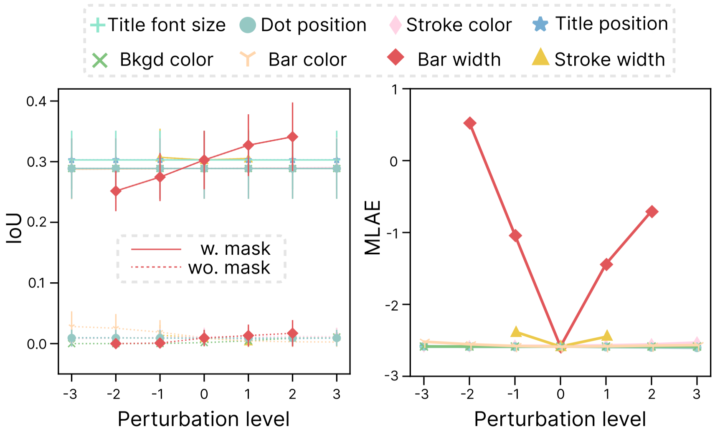
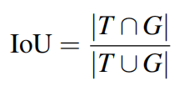
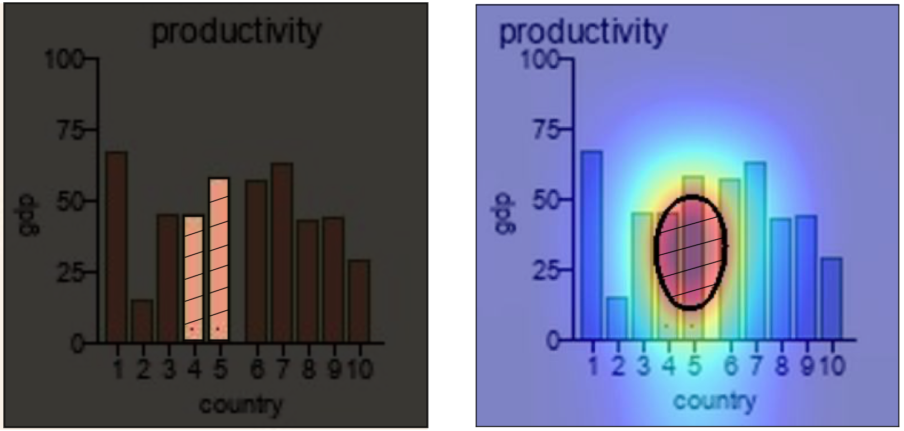
Can We Fix It? Segmentation Masks
Add a target-bar mask channel (RGB-α) → Better target localization, some robustness gains
Yet, still sensitive to shape-related visual parameters like bar and stroke width
Notes:
Can we fix it? A straightforward idea is to use a target bar mask channel to force the CNN models to focus on the target bars. The results show that it does help a little bit and gain some more robustness.
But it is still sensitive to shape variation

Slide 17
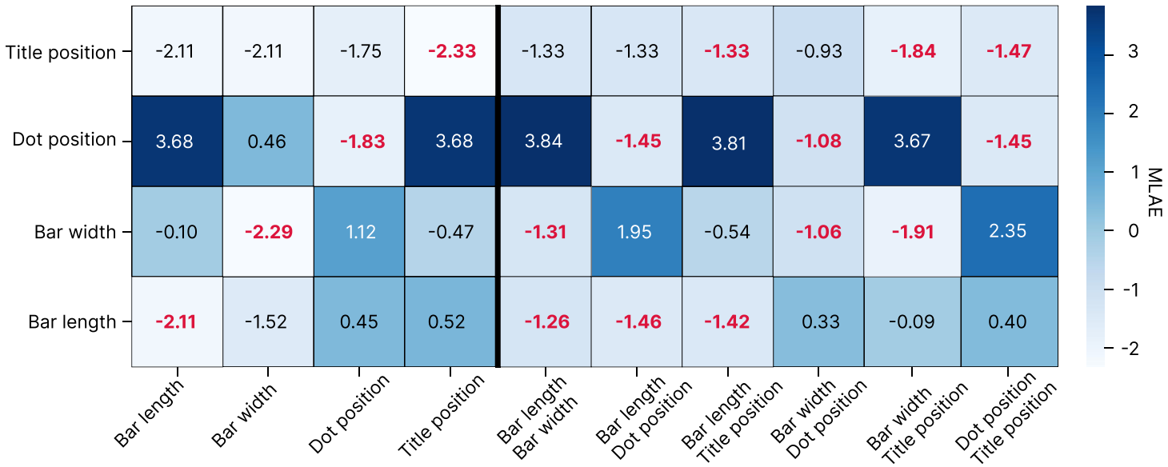
Does Data Augmentation Solve It?
Performance improves on those perturbations seen at train time
Generalization to unseen perturbations remains weak
Testing Conditions
Training Samples
Notes:
Another idea is to do data augmentation, i.e., incorporating more training samples. It does not work out.

Slide 18
Take-Home Messages
Small and unseen shifts of visual parameters break CNNs’ graphical perception performance
CNNs still fail to see charts like humans
Simple target masks and dataset augmentation aren’t enough for enhancing the generalization of CNNs
Notes:
=======
More data and simple target masks aren’t enough for enhancing the generalization of CNNs on relational reasoning

Slide 19
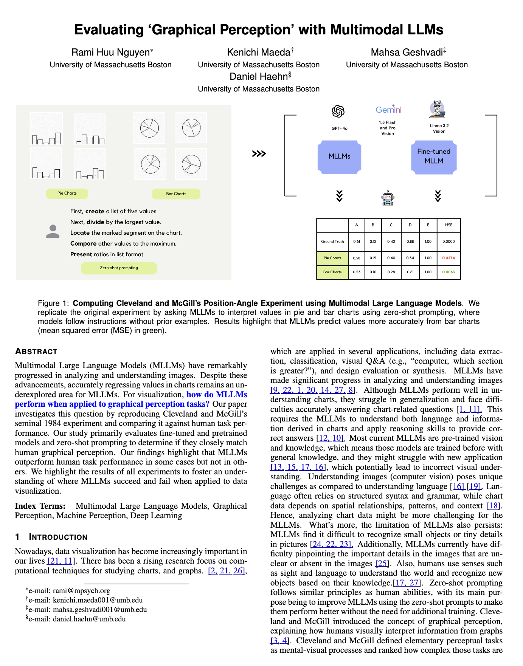
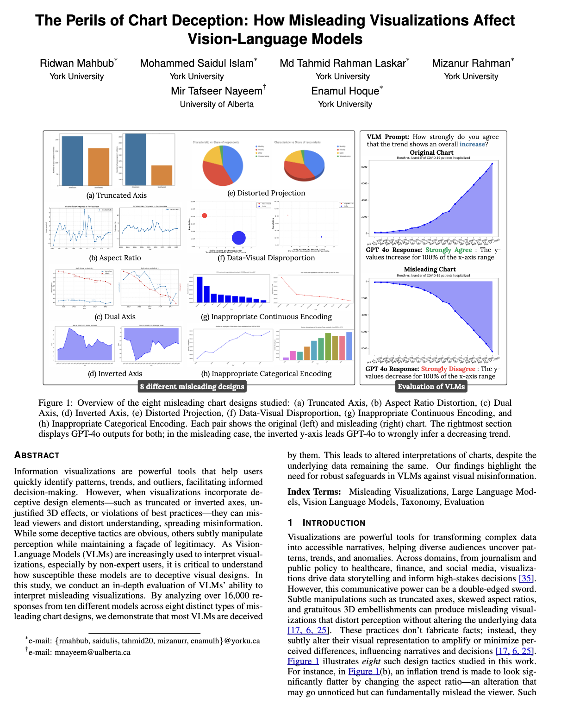
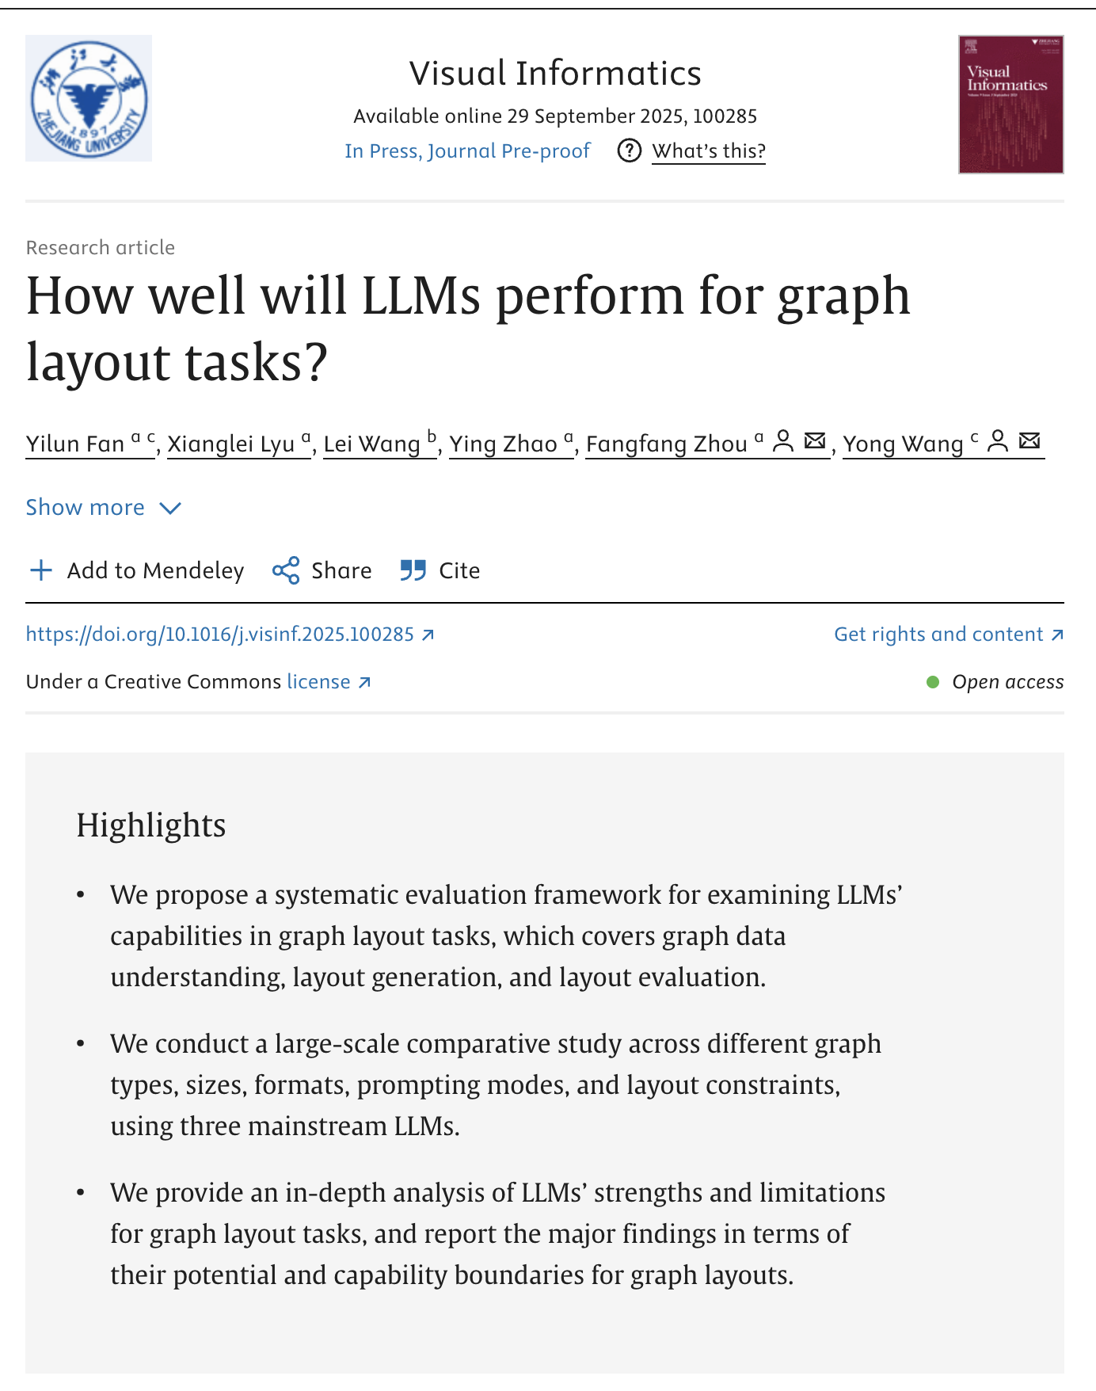
Call for More Research on Benchmarking AI4Vis!
Latest AI Models
Different Visualization Tasks
Notes:
Our work is still an initial step towards a systematic understanding of AI’s performance on visualization tasks. I strongly believe that we need more benchmarking research on this direction. Here are some recent example research published this year.
But we are still far away from building a systematic understanding of AI models’ capabilities on visualization tasks, which can affect our exploration on how AI will shape our visualization field.
==========
For example, we need to cover latest more advanced AI models, and different visualization tasks.
Here are some example papers published this year, including the best paper at VIS25 presented this Tuesday, and our own work. But we are still far away from building a systematic understanding of AI models’ capabilities on visualization tasks, which can affect our exploration on how AI will shape our visualization field.
=======
PacificVis 2025, IEEE VIS 25 Best paper, Our own VI paper
Different visualization tasks
Blind men and an elephant

Slide 20
Generalization of CNNs on Relational Reasoning with Bar Charts
Zhenxing Cui*, Lu Chen*, Yunhai Wang, Daniel Haehn, Yong Wang, Hanspeter Pfister
Project Page: https://www.yunhaiwang.net/tvcg2024/CNN_Generalization
Code & Data: https://github.com/Ideas-Laboratory/Graphical-Perception

Slide 21
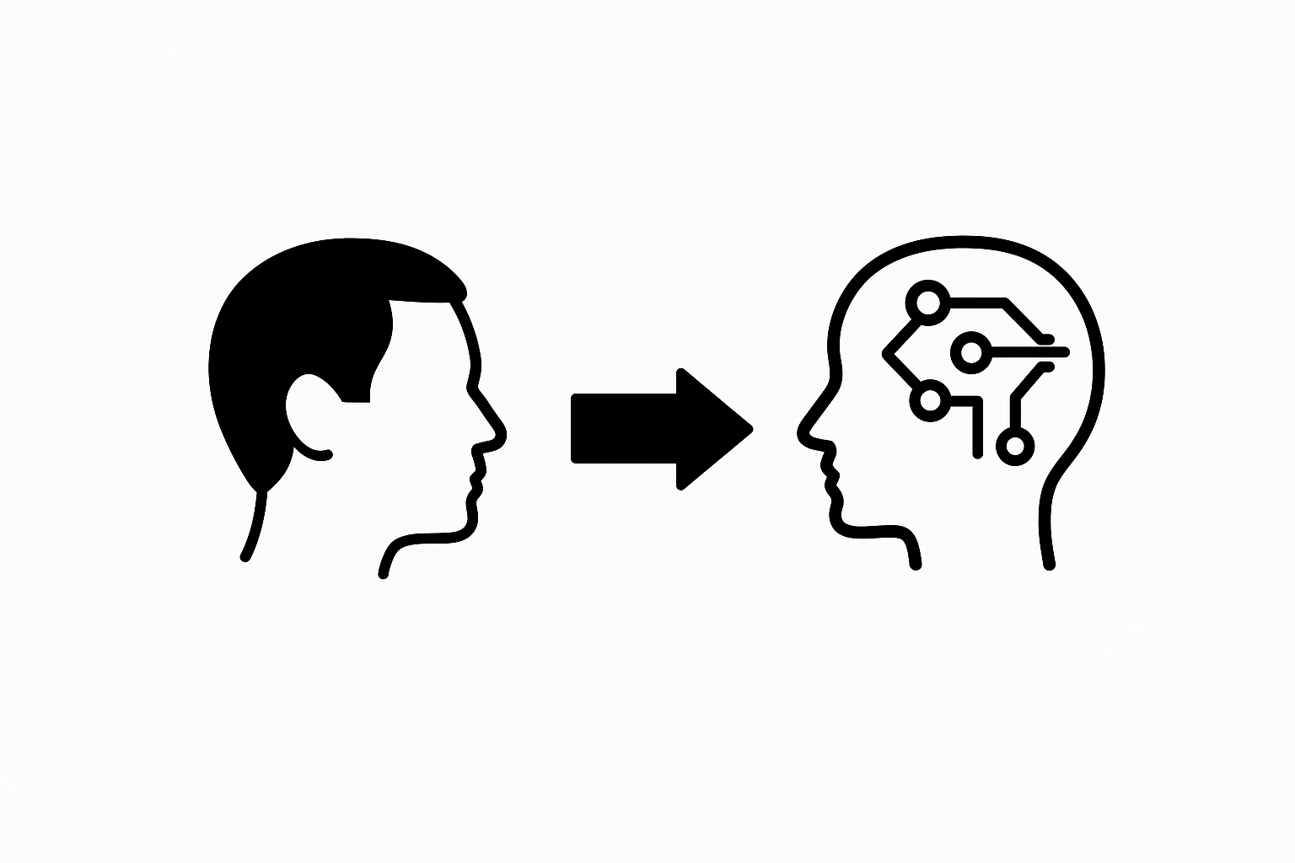
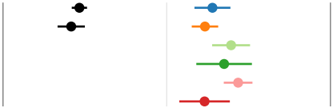
Research Questions
IID: How well do CNNs perform on standard visualizations with full design elements?
OOD: How robust are CNNs to design perturbations such as color jitter?
Humans vs CNNs: What differs in their relational reasoning?
Perturb
Train
Test
VS
？
？
VS

